Slide 1
Rare-earth nitride films
Electronic structure of SmN, DyN and GdN

Slide 2
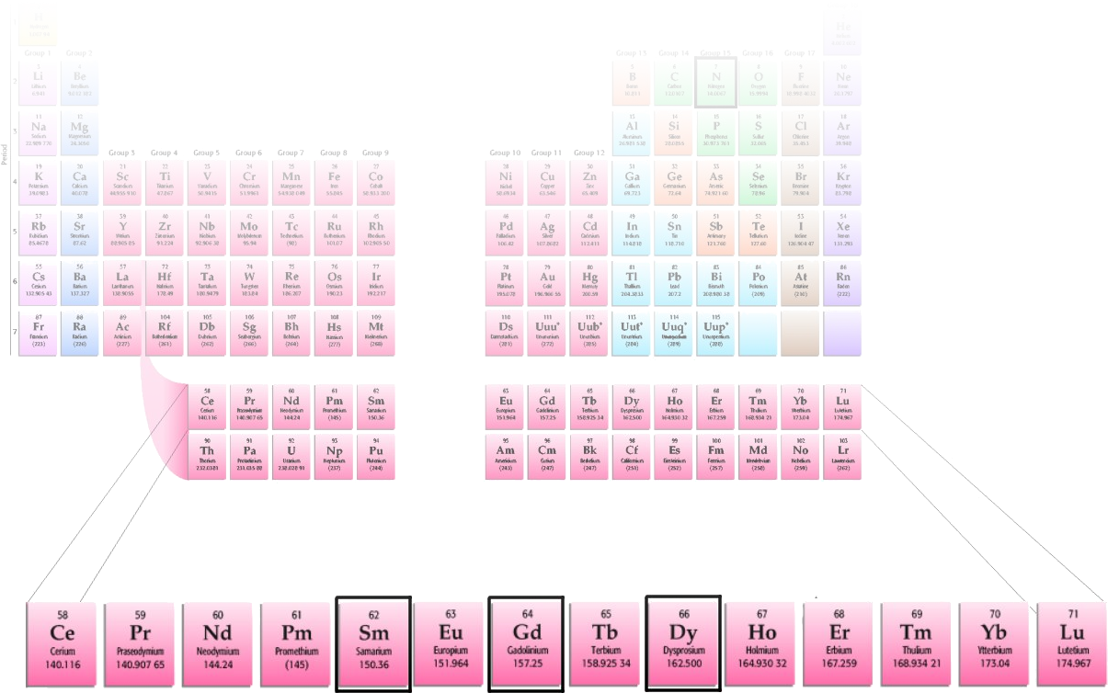
Motivation
Localized 4f electrons and delocalized band electrons - a frontier for theory
  Numerous theoretical predictions
    Half metals?
  No consensus!
Very little experimental data

Slide 3
Experimental investigation of electronic band structure
Methods
  Growth (in presence of N₂)
  Resistivity
  Magnetisation (SQUID)
  XAS/XES (done at BNL)

Slide 4
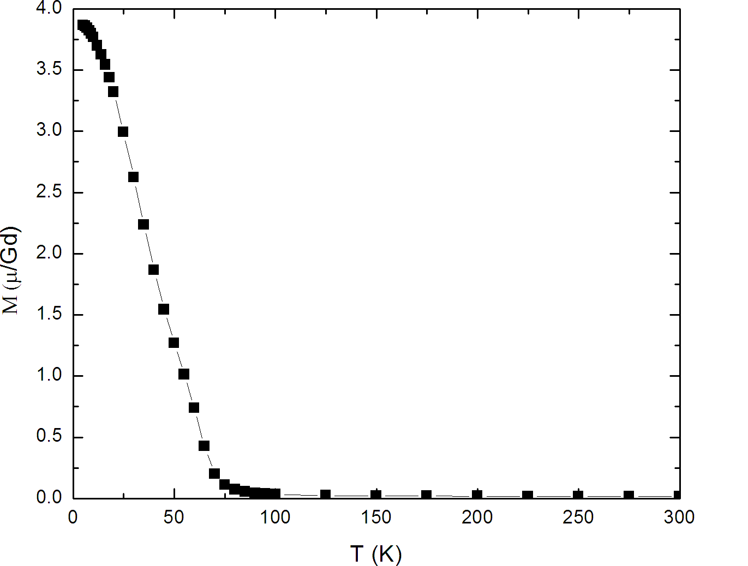
Magnetisation… (GdN)
Ferromagnetic, T_{c} ~ 68K
7µ_{B}/Gd saturation magnetisation
Granville et al, “Semiconducting ground state of GdN thin films” Phys. Rev. B, 73, 235335 (2006)

Slide 5
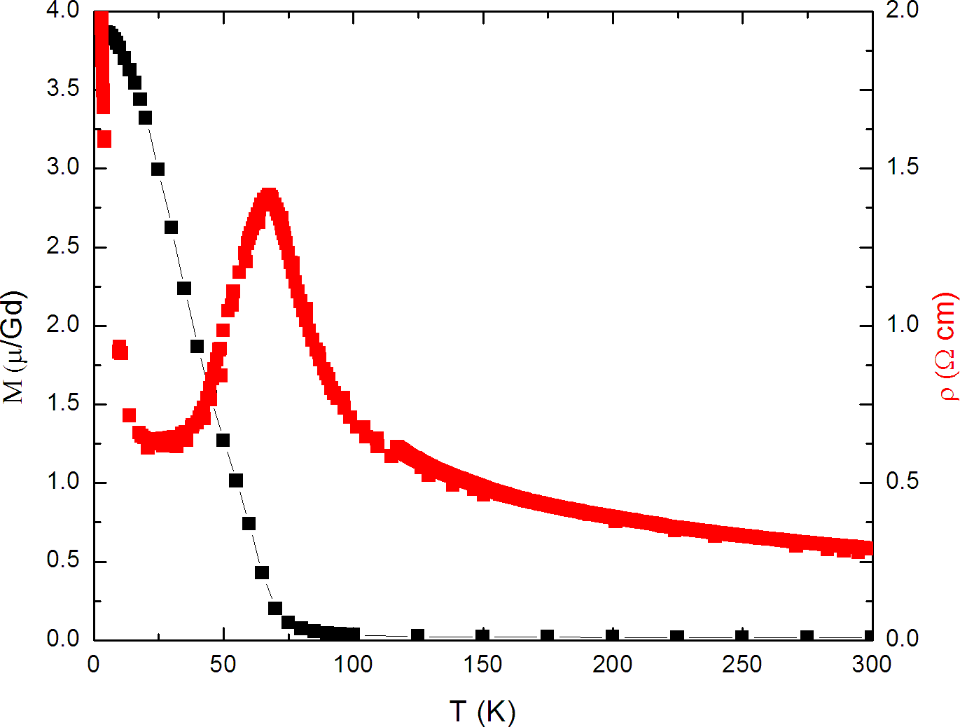
…and Resistivity (GdN)
Shift in the band edge
But still semiconducting!
Granville et al, “Semiconducting ground state of GdN thin films” Phys. Rev. B, 73, 235335 (2006)

Slide 6
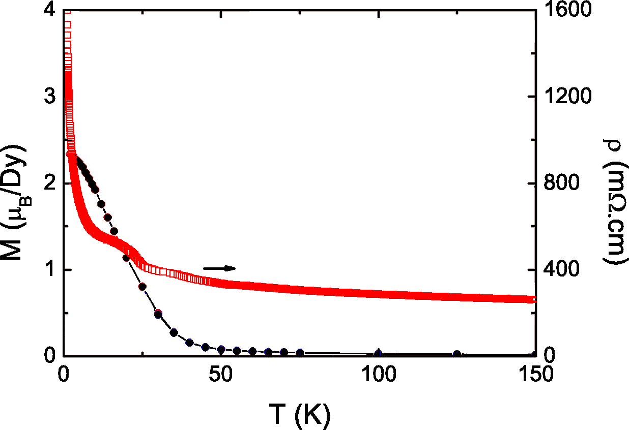
Resistivity & Magnetisation (DyN)
Semiconducting!
Ferromagnet (28K)

Slide 7
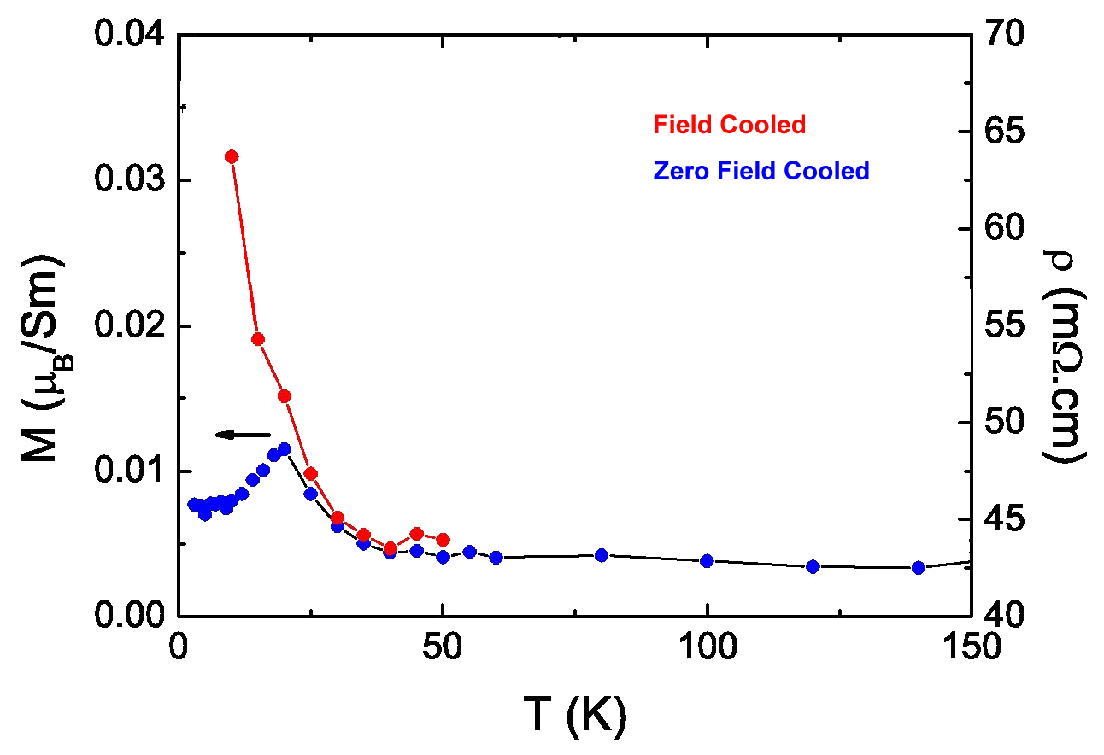
Resistivity & Magnetisation (SmN)
Previously reported as antiferromagnetic
Small moment – relatively large errors
Clear transition ~ 20K

Slide 8
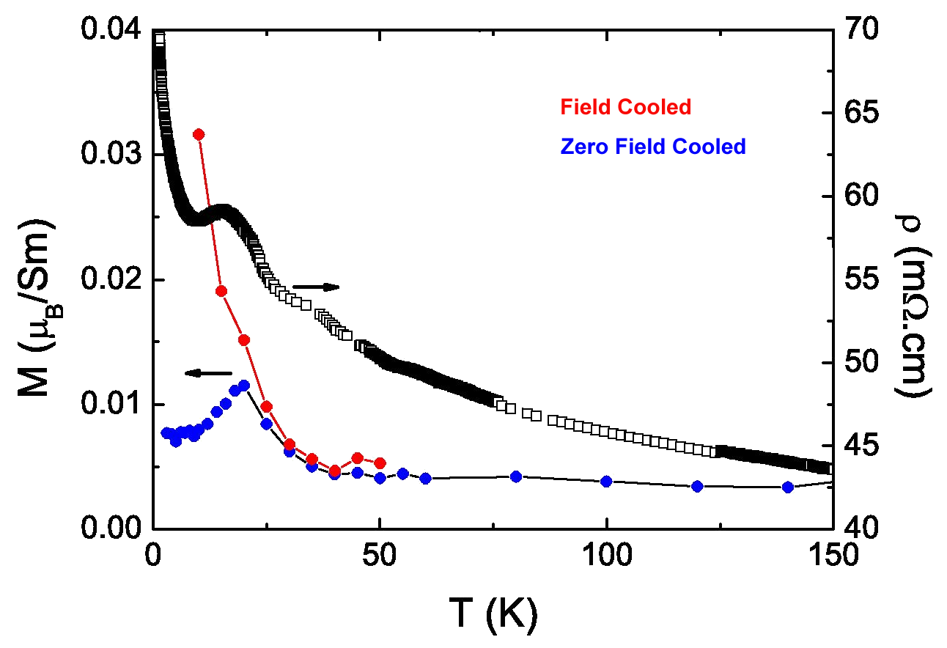
Resistivity & Magnetisation (SmN)
Semiconducting!
Anomaly at transition temperature

Slide 9
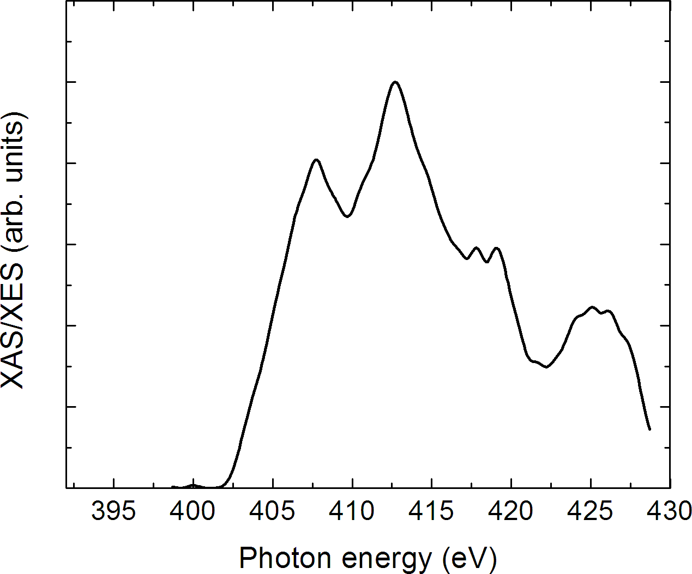
X-ray spectroscopy (DyN)
N k-edge, p-projected empty DOS

Slide 10
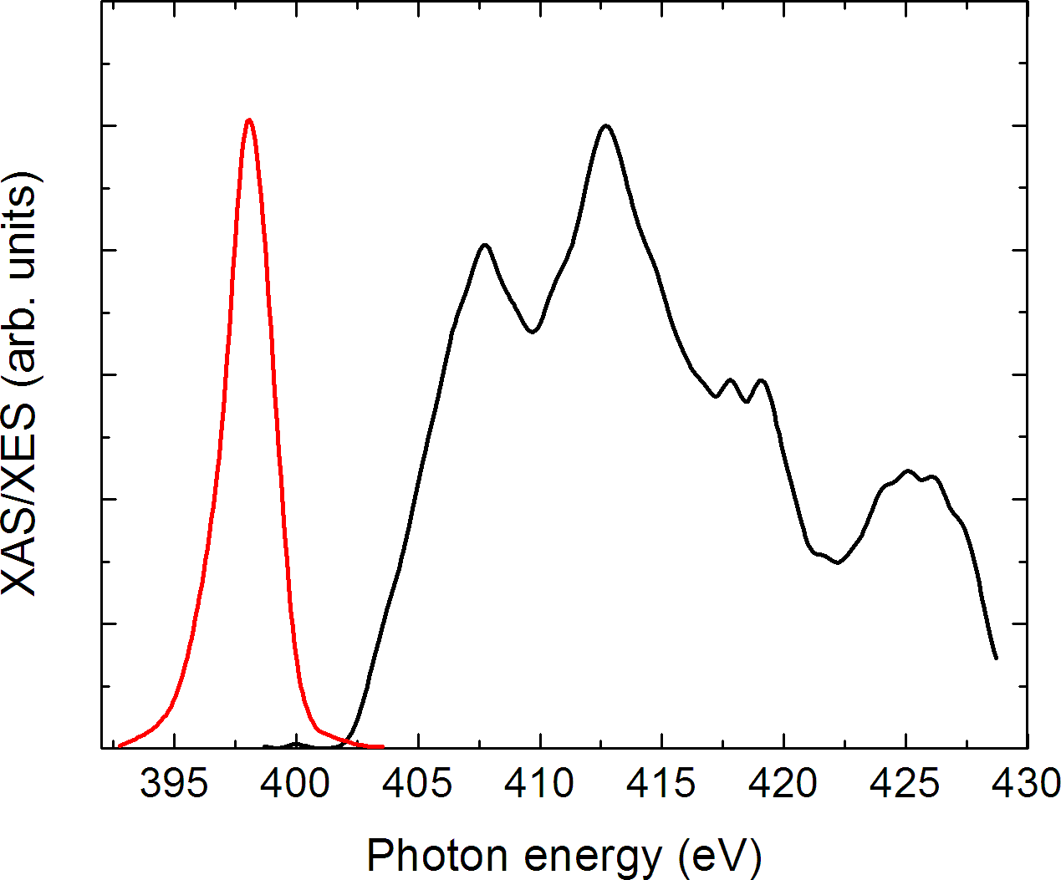
X-ray spectroscopy (DyN)
Clear evidence of gap between XES and XAS
Must be careful of core hole effects

Slide 11
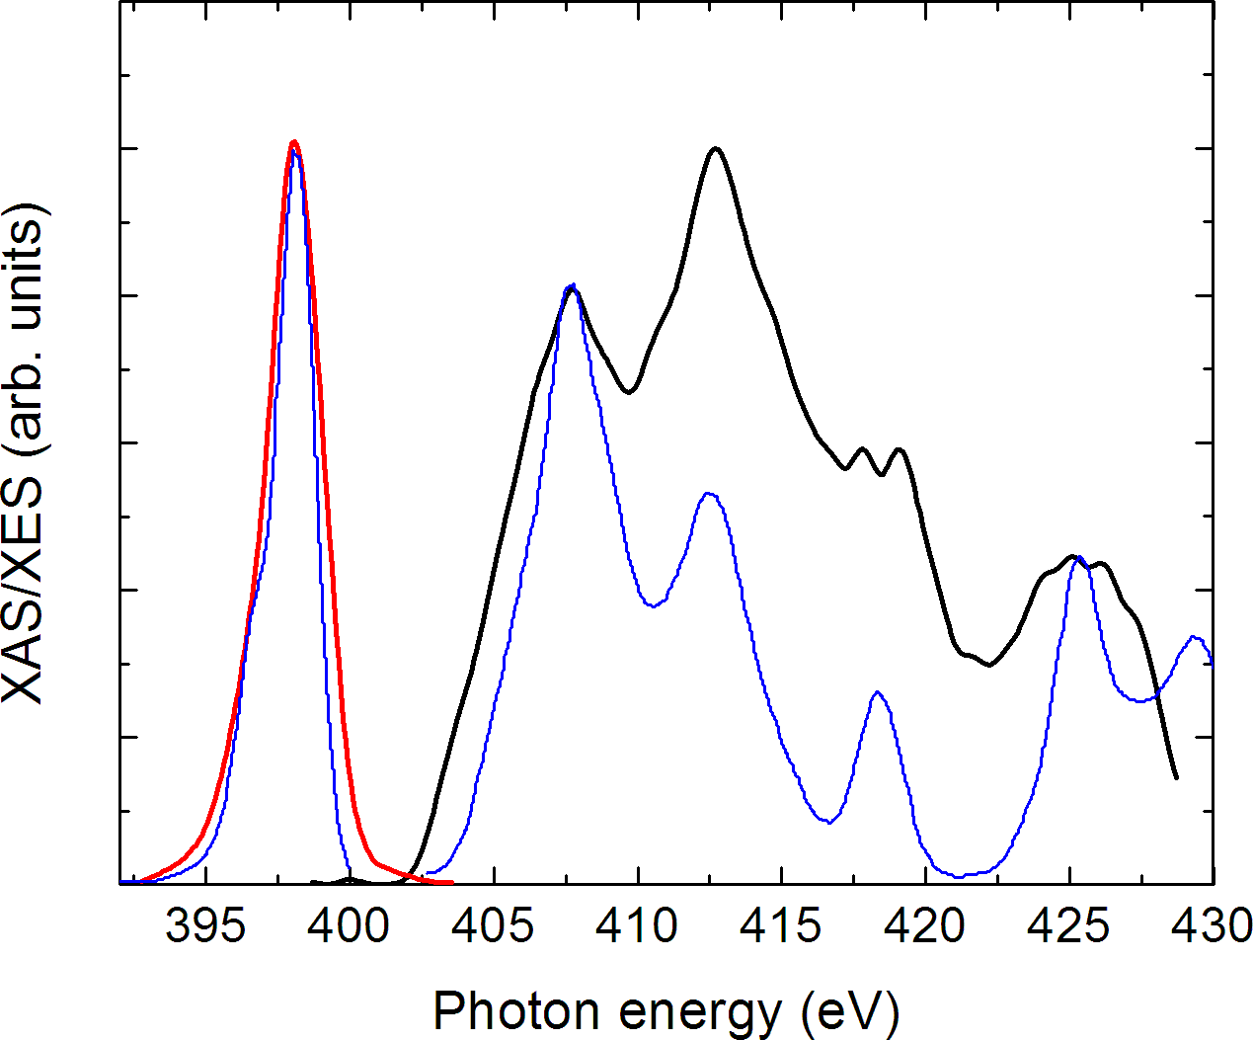
X-ray spectroscopy (DyN)
Compare directly with band structure calculations (in collaboration with Walter Lambrecht)
Very good agreement!

Slide 12
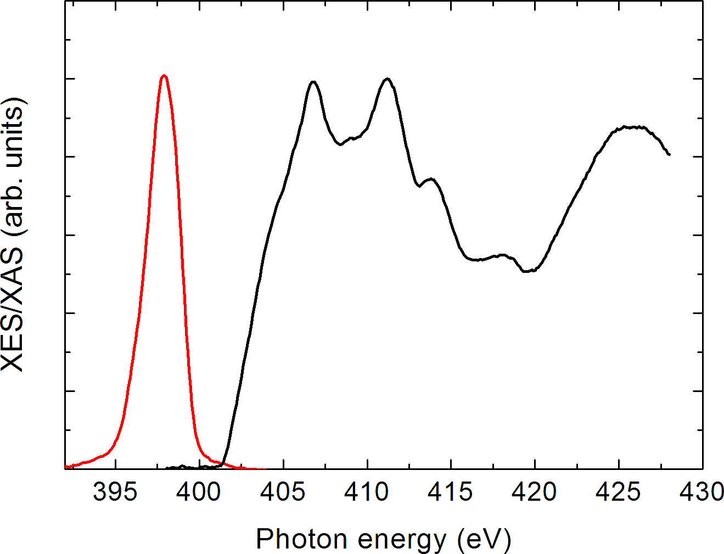
X-ray spectroscopy (SmN)

Slide 13
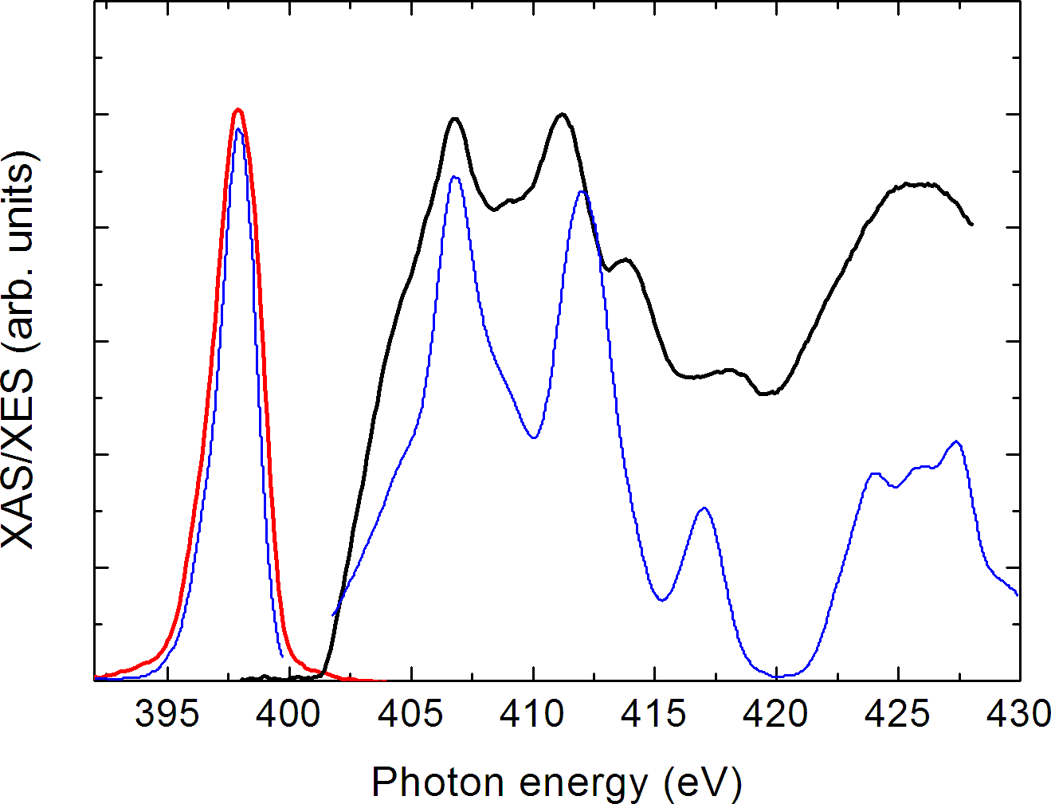
X-ray spectroscopy (SmN)

Slide 14
Summary
Semiconductors!
Anomaly in resistivity at T_{c} – a band shift
X-ray spectroscopy of valence and conduction bands. Theory is getting close!
Preston et al, “Band structure of SmN and DyN”, Phys. Rev. Lett., submitted

Slide 15
Acknowledgements
Ben Ruck, Jianping Zhong, Joe Trodahl
  Victoria University of Wellington
  The MacDiarmid Institute
Walter Lambrecht, Paul Larson
  Case Western Reserve University
James Downes
  Macquarie University, Sydney
Kevin Smith
  Boston University

Slide 16
Extra

Slide 17
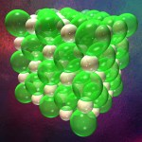
Overview
What are they
  Rock salt, RE³⁺ N³⁻
  Stronly localized 4f electrons with band electrons.
  Highly reactive (unstable in atmosphere)
and why?
  Tough on theory - numerous attempts
  No consensus!
  No experimental data to guide
  Half metals?

Slide 18
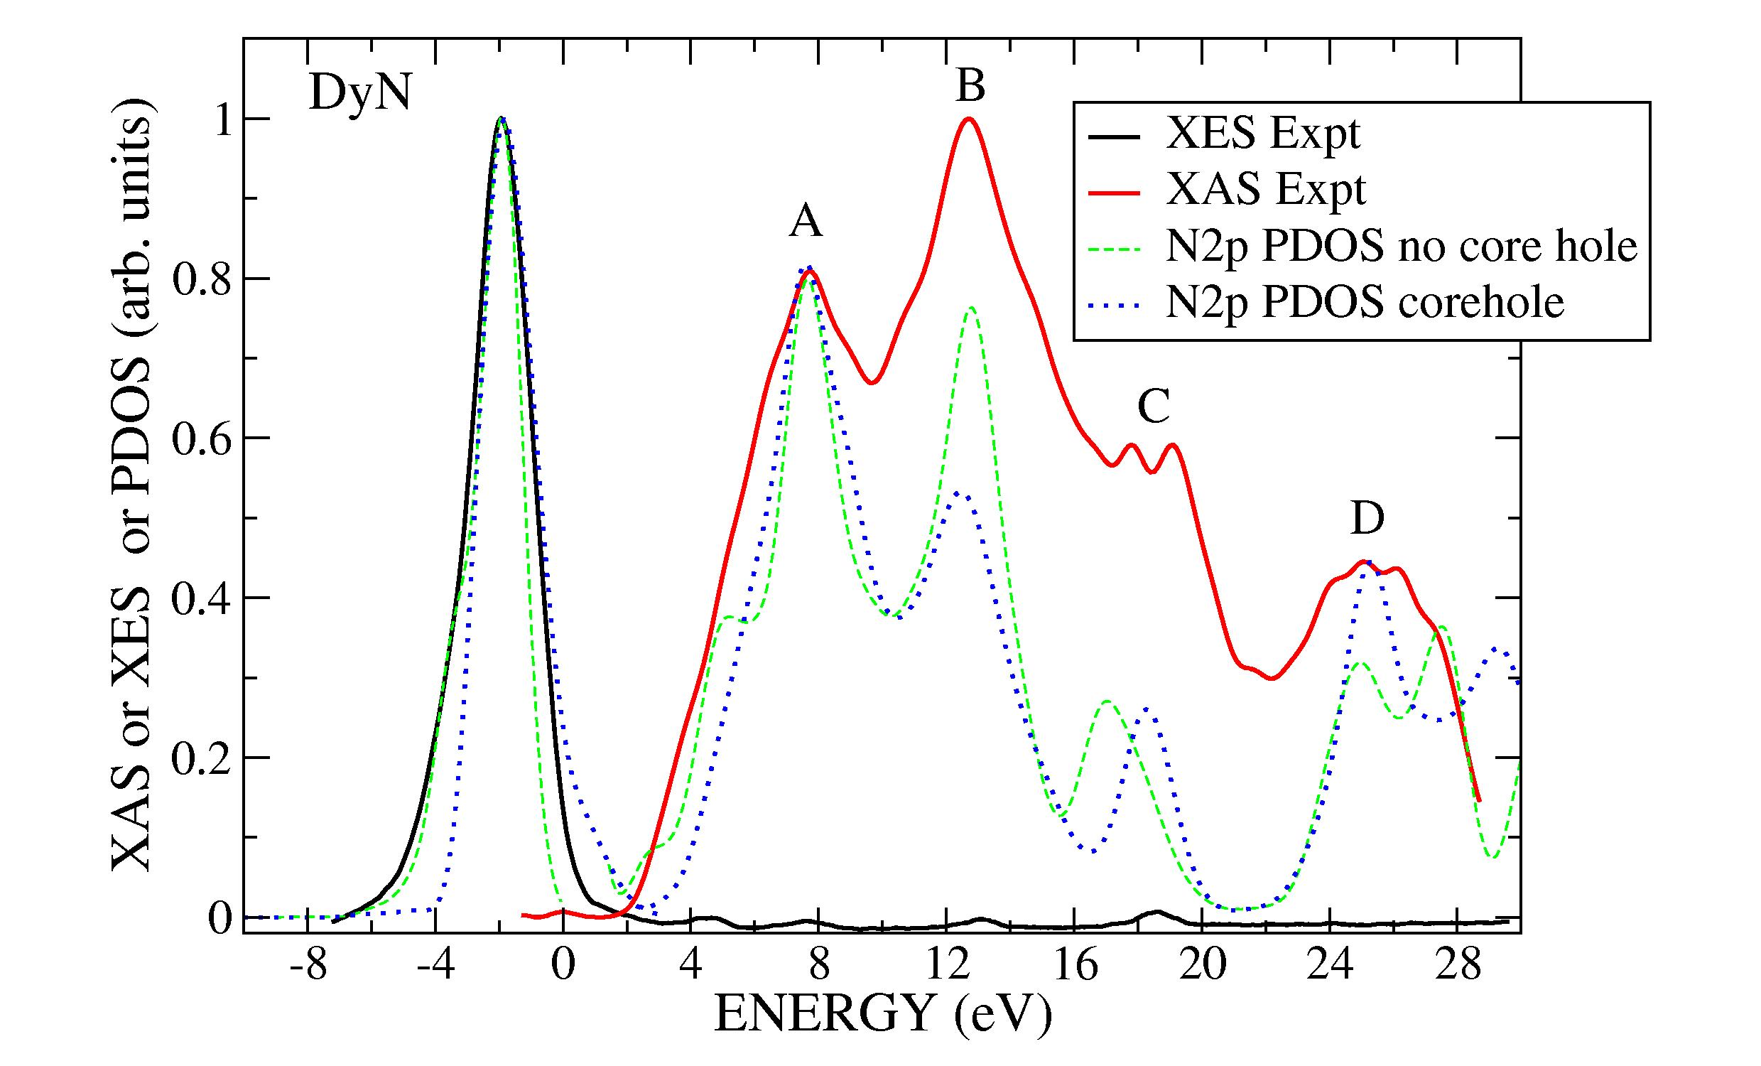
Extra Results – XxS (DyN)

Slide 19
Results – XxS (SmN)

Slide 20
Methods
Theoretical
  LSDA+U (W.R.L. Lambrecht)
  LSD-SIC (Aerts et al)
No consensus!

